Slide 1

www.koda4kids.com email: info@koda4kids.com
KODA - 4 - KIDS
& Holland Heights

Slide 2
What?
100 + students at Holland Heights Elementary School will be able to register for the KODA 4 KIDs store.
At the store, 100 + students from Holland Heights will receive a brand-new winter coat, snow pants, hat, gloves, snow boots, and socks.
Each student receives a kid’s bag to put their items in.
Cost of the event is $10 per child.

Slide 3
Why?
The Holland Heights vision was born many years ago but never acted upon. Now is the time to put our thoughts into action. KODA 4 Kids was created April of 2021 after a team business meeting. The tug on our hearts showed us that the needs in our community were basic and great.
We chose to focus our efforts within a mile of our business, Holland Heights Elementary School. We knew the needs of the students at this school were great and many of the children lived within walking distance of our business.
Our goal is to provide as many students as possible (min.100) with a new winter coat, snow pants, boots, hats, mittens and socks.

Slide 4
School Relationship
Our family grew up in the Heights and our kids had the privilege of going to Holland Heights Elementary School. That has been some years ago, but we are excited to start a new relationship!
KODA 4 KIDS does not want to be a one and done. We have visions of expanding & supporting in different ways as well.
2022 or sooner
  Teachers supplies throughout the year.
  Supply Teacher conference times with meals / snacks.
  Commit to dropping off coffee and bagels/doughnuts.
  Basic supplies to students Quarterly.
  Be available for help requests for family needs.
Each family, if possible, would be given a basket of household items including toilet paper, toothbrushes, and cleaning supplies. Each basket also would include sponsors and a poem / phrase of encouragement.

Slide 5
Item Collection
We are collecting New Items
For staff and families of Holland Heights
Coats Black snow pants
Mittens/Gloves Boots & Hats
School supplies Socks
Collecting through OCTOBER 9, 2021
We will shop from clearance sales at local stores to begin stocking items for this event. We will ask for support from businesses and stores like our local Meijer, Kohls and Walmart .
For weeks we will collect NEW items from our community and our customer base. We request only new items not only because we want to make sure items will last, but also because we know many of these students have never had a brand-new coat before.

Slide 6
Item Collection
We will collect items in bins located at our business office located at 100 S. Waverly Rd. Holland, MI 49423, Suite 102.
We will create an Amazon Wishlist for those who are not comfortable shopping in stores, and it can get shipped directly to KODA 4 KIDS.
We also will collect monetary donations and we will do additional shopping as needed.
  All donation go to run KODA 4 Kids. No salary or wages are paid in any fashion to any single staff member/officer.

Slide 7
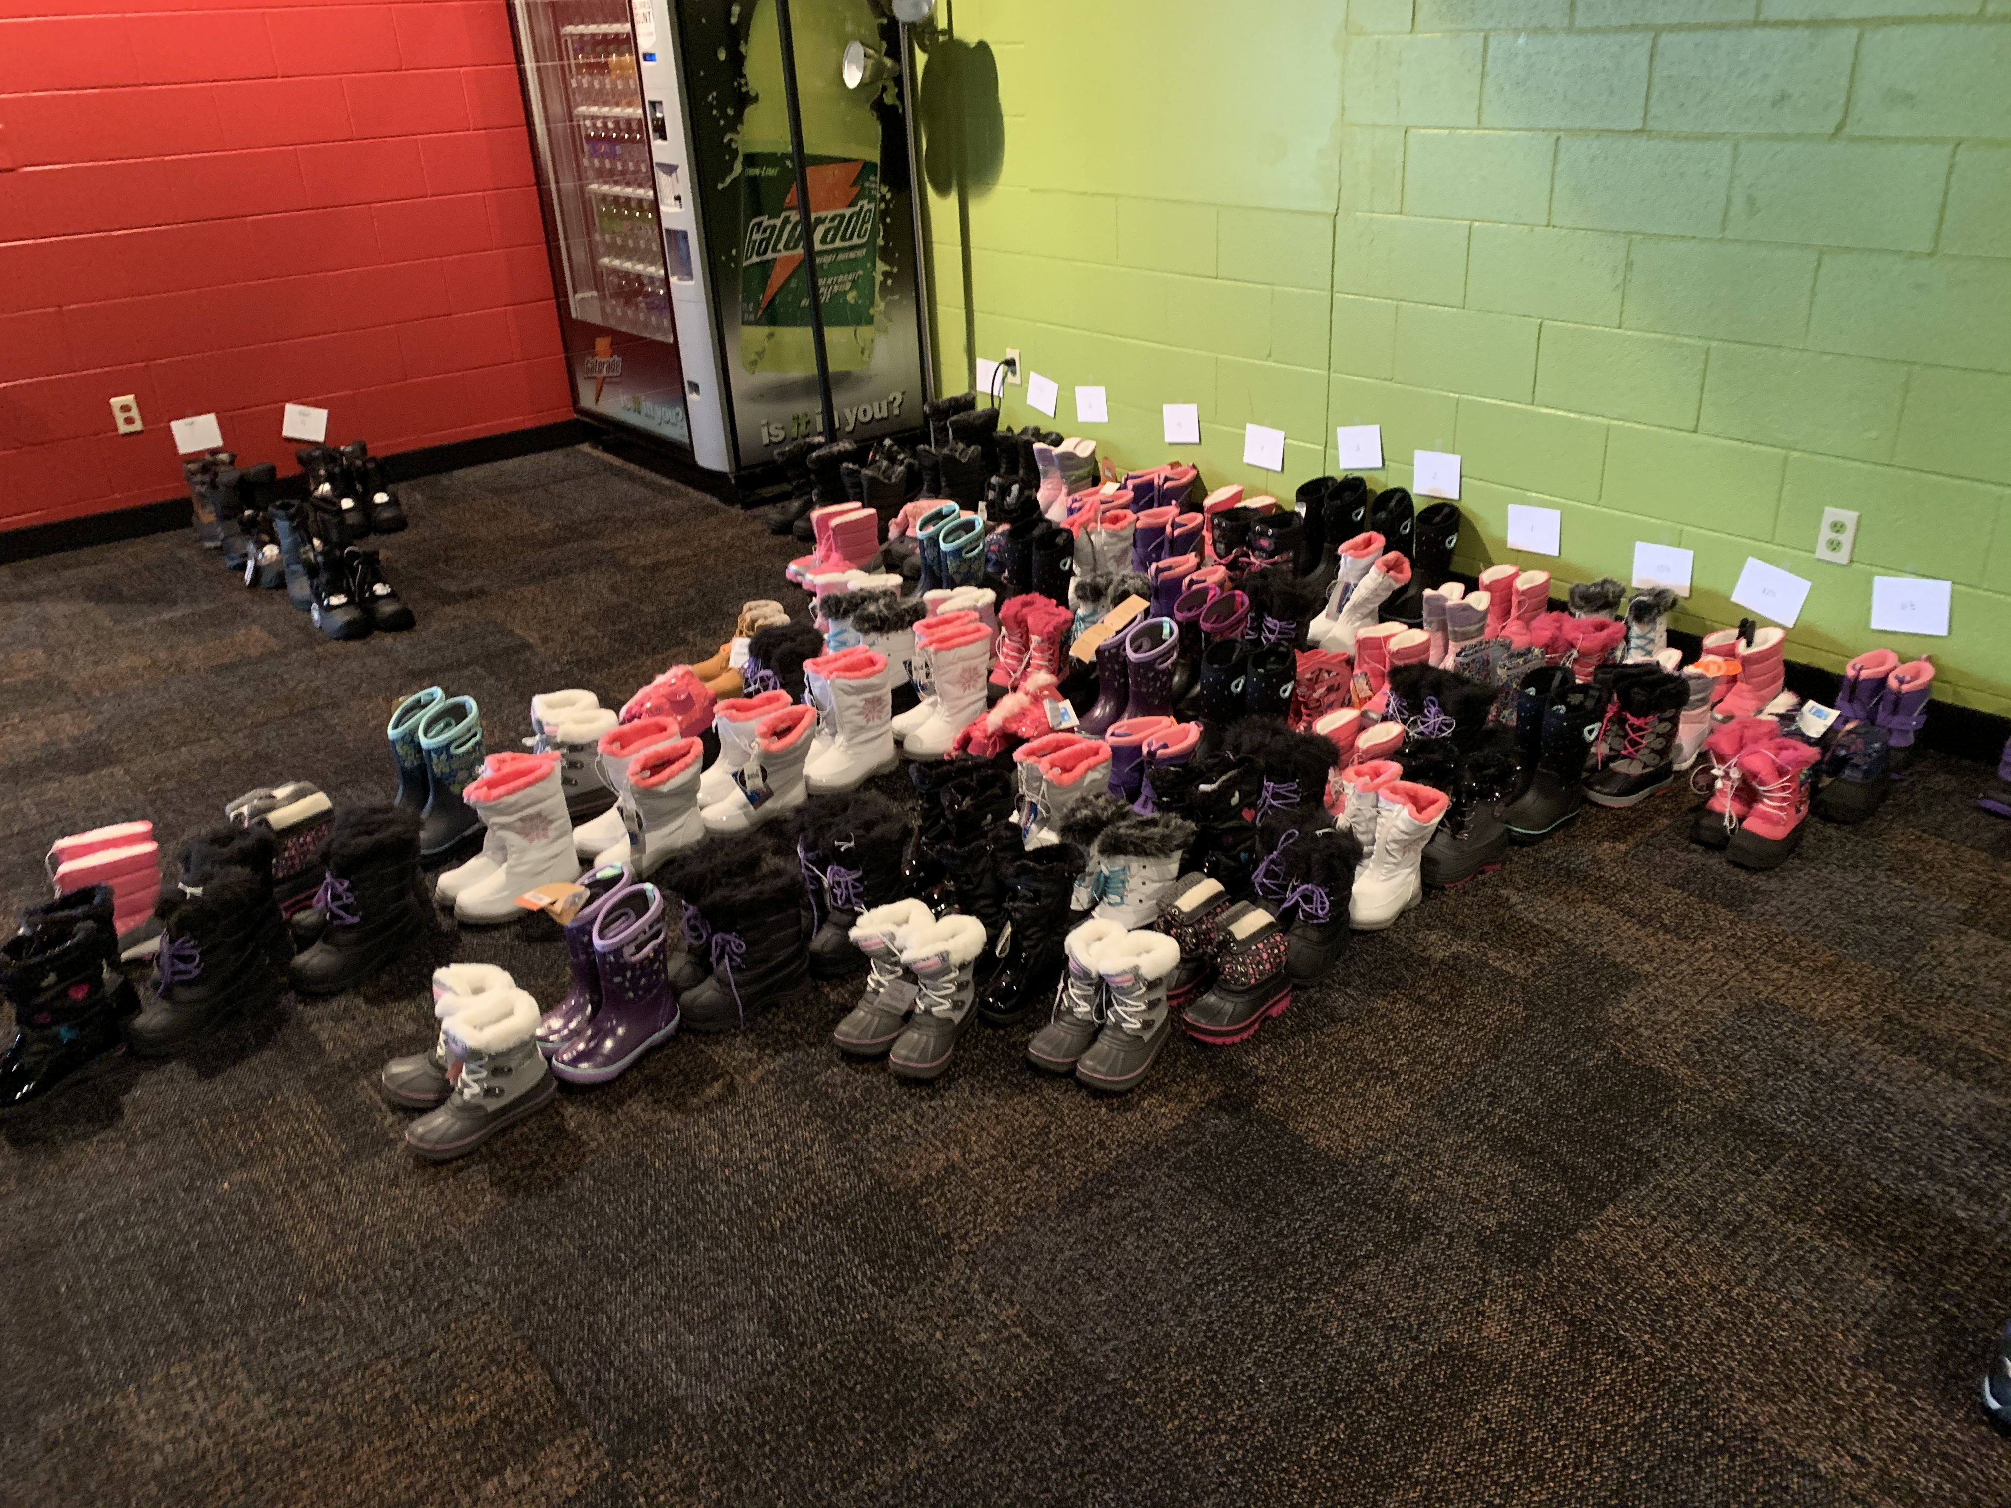
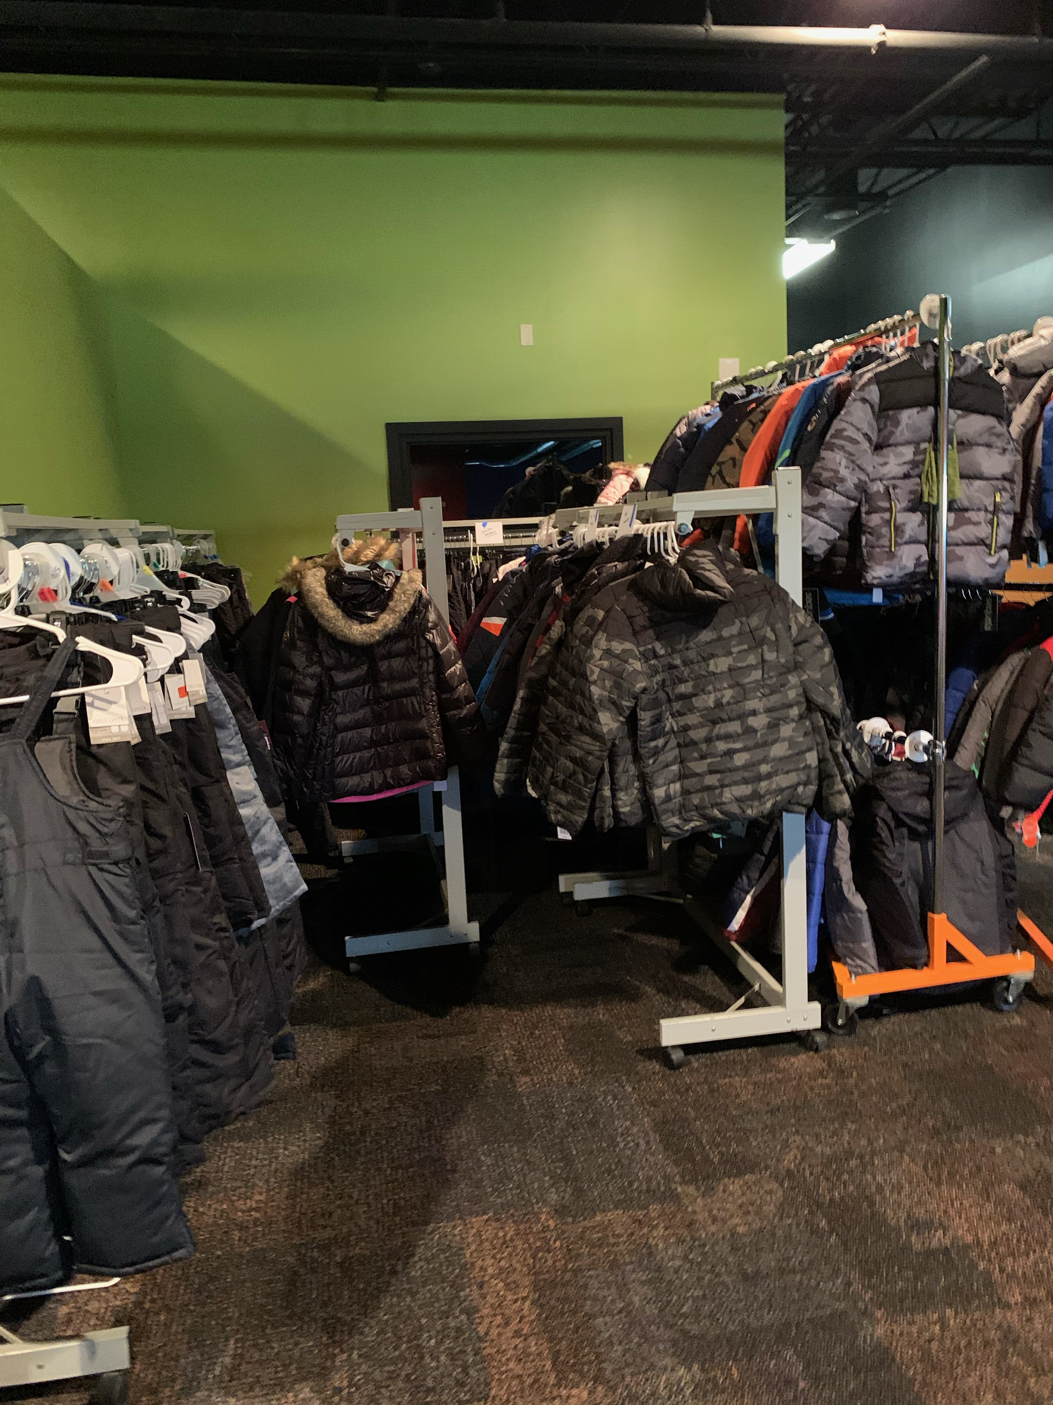
Item Organization
As items come in, we will keep them organized by item, gender and size. Doing this as the donations come in keeps it organized, simple and accurate.
Having the items organized this way makes it possible for us to see gaps in what was donated. We will be sure to have two or three extra in each size after families are registered so to be sure not run out of any size.

Slide 8
Invitation
KODA 4 KIDS will provide Holland Heights with all appropriate forms for families.
We will ask of Holland Heights to help us in selecting the 100 students that Holland Heights feels would be the best to benefit from the store.
Our request is for Holland Heights to send registration forms home with the appropriate students. KODA 4 KIDS will come in and collect all registrations. We must have a registration on file for a family to shop.
We have been approved to use the gym as the store. We will work with Holland Heights to schedule one or two (1 or 2) evenings to accommodate all families.
The registration letter is in English on one side and Spanish on the other.
The $10 fee for the store is due at the time of the event not at registration so we do not need to keep track of who pre-paid.
We asked that registration forms are due two weeks prior to the event so we have ample time to make sure we have all sizes needed.

Slide 9
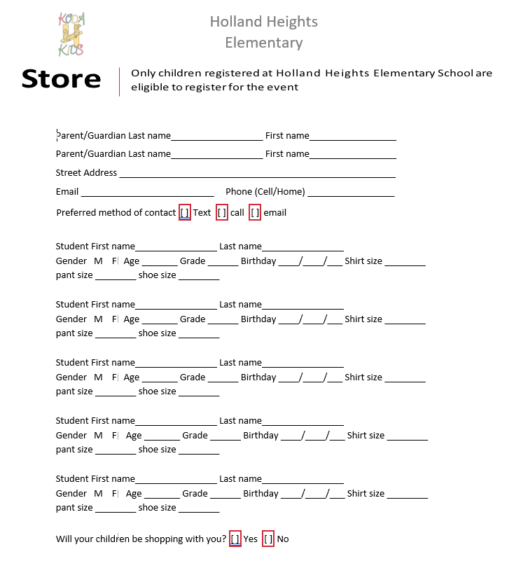
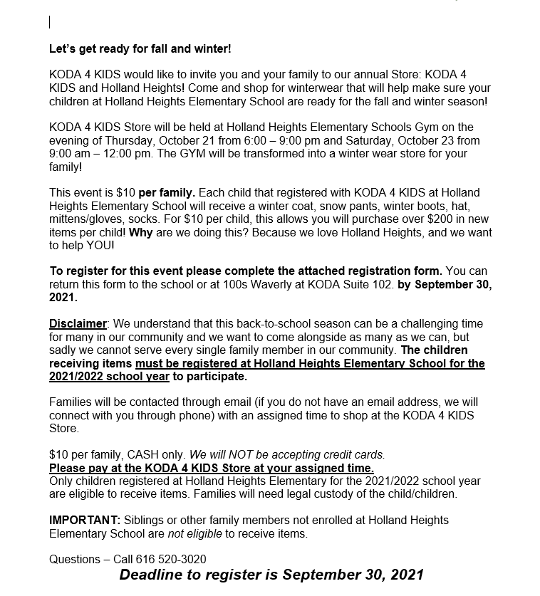
Invitation

Slide 10
Registration Information
We will utilize a spreadsheet to compile the information from the registration forms. This makes sorting the information easy and clear.
We will set up all family's times in alphabetical order. This will allow us to manage and control that not all families come at once.
We will call or email families with their assigned shopping day and time. We will schedule two families every ten minutes to shop. This leaves plenty of time and distance between families shopping.
A simple spreadsheet with shopping times and names will be checked as families come and shop.

Slide 11
Familys Shopping Experience
When families arrive to the KODA 4 KIDS at Holland Heights store, they will be greeted warmly, have their temperatures checked, and answered COVID-19 screening questions if still required.
They will be directed to a registration table. Two tables will be labeled A-M and N-Z. There they will meet the volunteer that is going to walk them through the gym and help them shop with what is on their registration form.
  Volunteers are given a shopping checklist with all the items needed as well as the children's sizes. They will also give each shopper a bag for each child's items.

Slide 12
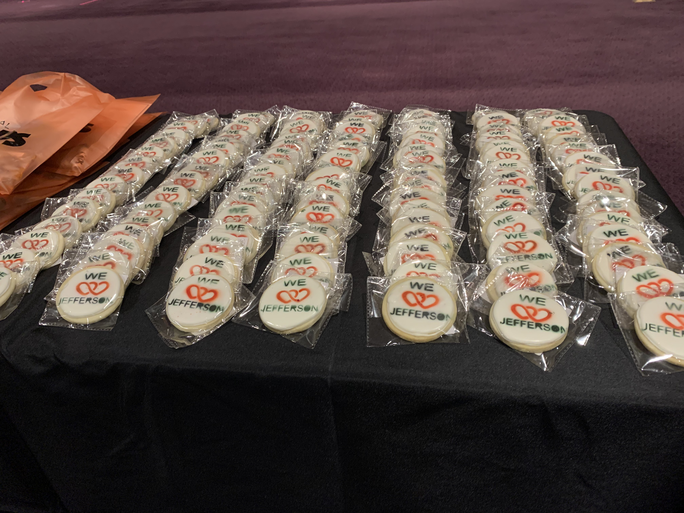
Family Shopping Experience Cont.
At each station families will be greeted by a volunteer who will help them find the appropriate size for their child.
They will write the children's initials inside their new items with a sharpie. This simple act will give the kids a sense of ownership of their new items and will help when they end up in lost and found at school.

Slide 13
Family
Shopping Experience Cont.
Families will walk through the following stations; coats, snow pants, hats, mittens, boots and socks.
When the shopping is finished the volunteer helps the family get all their items to their car. Once to the car volunteers will offer a simple statement to assist in the future if possible and leave them with a phone number.
The volunteer will come back into the building and write a note to the family. The notes is a simple wish stating we were excited to help and “It was so great to meet them!”
These notes are sent out around December 1, asking how things are going and if we can help with anything.

Slide 14
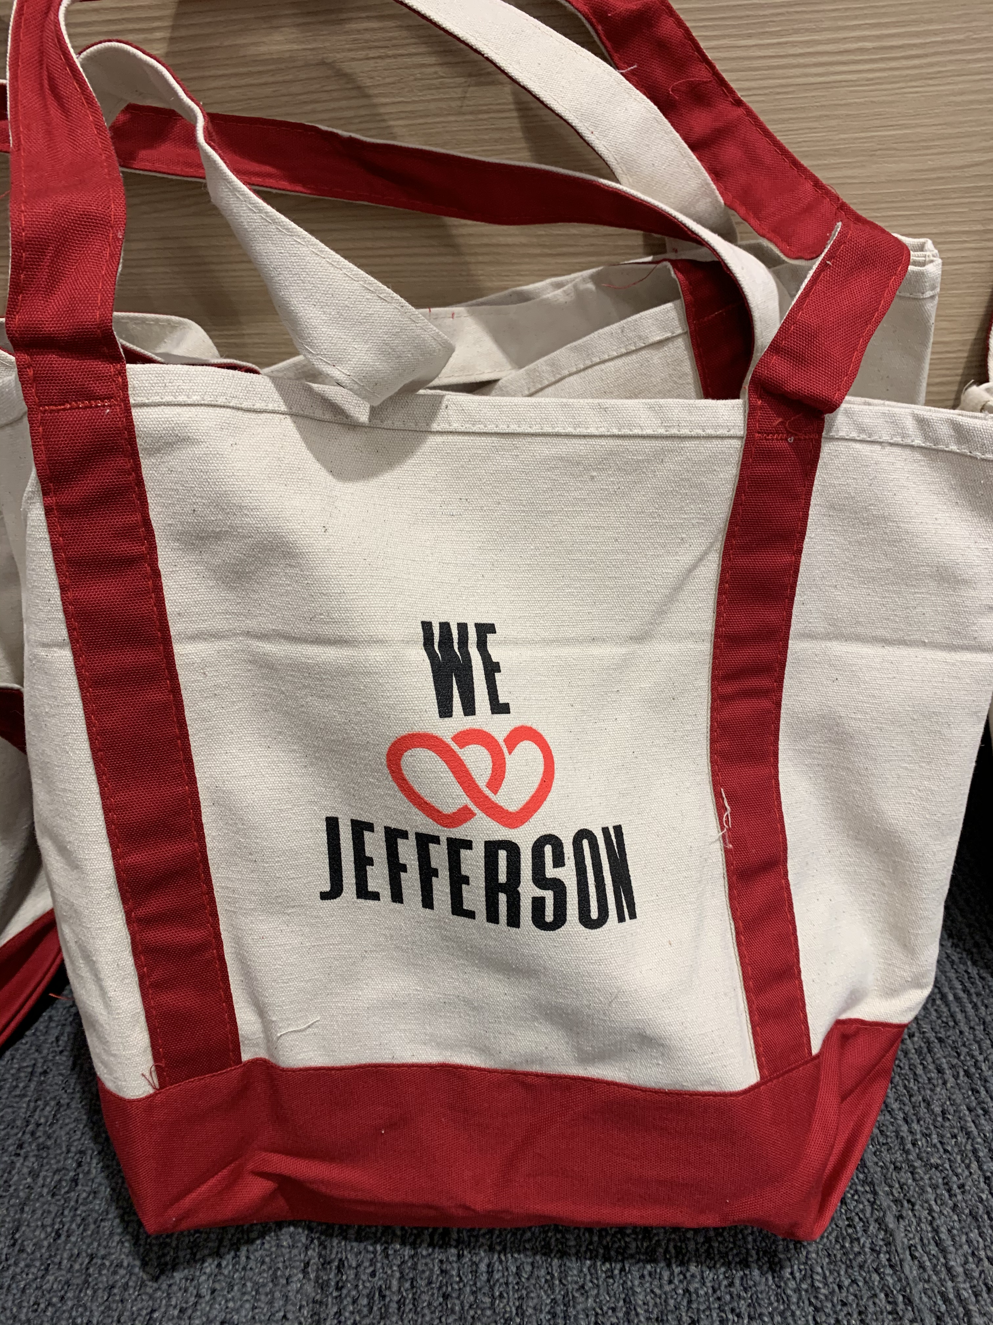
We Love Holland Heights Teachers
The second stage of KODA 4 KIDS for Holland Heights is all about the teachers.
Twelve K-5 classroom teachers will be invited to come shop for much needed school supplies for their classroom. Supplies range from pencils and glue sticks to notebooks and activity books and snacks for the kids.
The goal for Teachers is for them to be able to receive about a $100 worth of supplies.
When teachers arrive, they will be greeted by volunteers and walked through the teacher shopping room.
Our Future Goals

